Slide 1
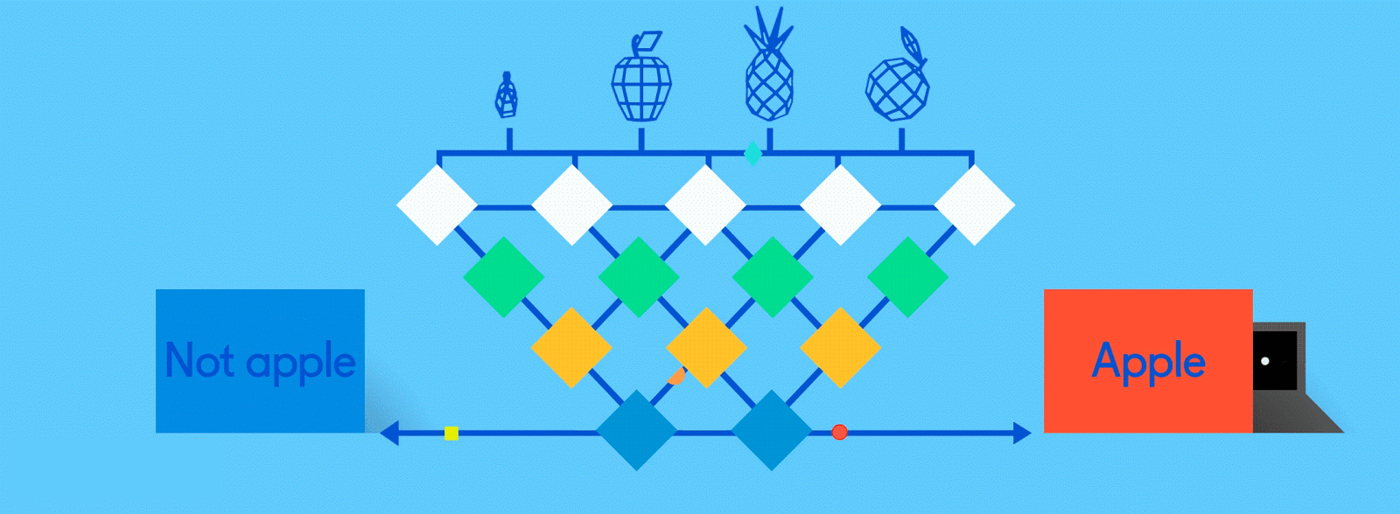
Neural Networks for Machine Learning

Slide 2
Neural network
Node performs computation via an activation function
Notes:
Set of nodes
Node have inputs and outputs
Nodes performs computation via its activation function
Weighted connections between nodes
Connectivity gives structure/architecture of net
What can be computed by a NN determined by the connections and their weights
Simplified version of networks of neurons in animal nerve systems

Slide 3
Not with a perceptron ☹
Consider Boolean operators (and, or, xor) with four possible inputs: 00 01 10 11
Training examples are not linearly separable for one case: sum=1 iff x1 xor x2

Slide 4
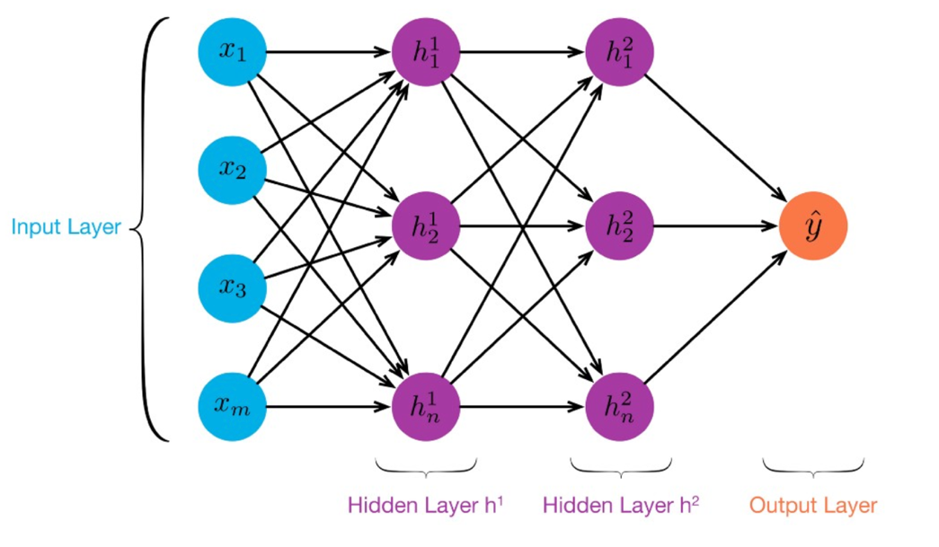
MLP: Multilayer Perceptron
≥ 1 “hidden layers” between inputs & output
Can compute non-linear functions (why?)
Training: adjust weights slightly to reduce error between output y and target value t; repeat
Introduced in 1980s, still used today

Slide 5
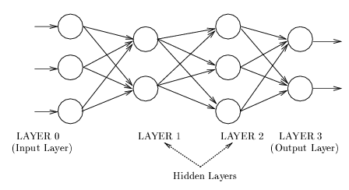
Feedforward Neural Network
Connections allowed from a node in layer i only to nodes in layer i+1, i.e., no cycles or loops
Simple, widely used architecture, provides a good baseline
Backpropagation used while training, of course
downstream nodes tend to successively abstract features from preceding layers

Slide 6
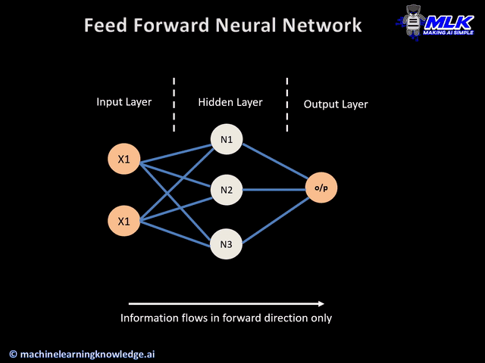

Slide 7


Slide 8

1. Select dataset
2. Choose features
3. Add layers
4. Parameters
5. Task
http://playground.tensorflow.org/

Slide 9
TensorFlow Playground
Great javascript app demonstrating many basic neural network concepts (e.g., MLPs)
Doesn’t use TensorFlow software, but a lightweight js library
Runs in a Web browser
See http://playground.tensorflow.org/
Code also available on GitHub
Try the playground exercises in Google’s machine learning crash course

Slide 10

http://playground.tensorflow.org/

Slide 11
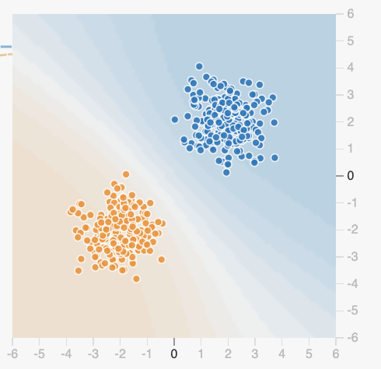
Datasets
Six datasets, each with 500 (x,y) points on a plane where x and y between -5 and +5
Points have labels of positive (orange) or negative (blue)
Two possible machine learning tasks:
Classification: Predict class of test points
Regression: find function to separate classes
Evaluation: split dataset into training and test, e.g., 80% training, 20% test

Slide 12
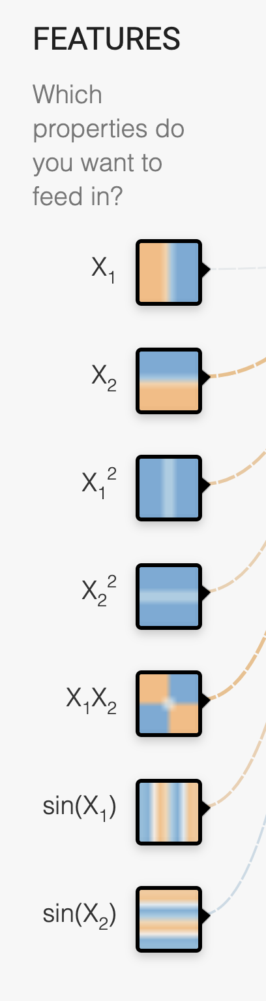
Available Input features
X₁ Point’s x value
X₂ Point’s y value
X₁² Point’s x value squared
X₂² Point’s y value squared
X₁X₂ Product of point’s x & y values
sin(X₁) Sine of point’s x value
sin(X₂) Sine of point’s y value

Slide 13
Designing a neural network
Simple feed forward NNs have a few choices
What input features to use
How many hidden layers and their details:
How many neurons are in each layer
How each layer is connected to ones before & after
Complex NNs have more choices
E.g., CNNs, RNNs, etc.
High-level interfaces (e.g., Keras) try to make this easier

Slide 14
http://playground.tensorflow.org/

Slide 15
Training a Neural Network
Neural networks are used for supervised machine learning and need to be trained
The training process is broken done in a series of epochs
In each epoch, all training data run through the system to adjust the NN parameters
Process ends after a fixed # of epochs or when error rate flattens or starts increasing

Slide 16
Typical Training Flow
Divide training data into batches of instances (e.g., batch size = 10)
For each epoch:
For each batch:
Instances run through network, noting difference between predicted and actual value
Backpropagation used to adjust connection weights
Stop when training loss flatten out
If test loss is too high, then try
Adding additional hidden layers
Adding more features to inputs
Adjusting hyperparameters (e.g., learning rate)
Get more training data

Slide 17
Hyperparameters
Parameters whose values are set before the learning process begins
Basic neural network hyperparameters
Learning rate (e.g., 0.03)
Activation function (e.g., ReLU)
Regularization (e.g., L2)
Regularization rate (e.g., 0.1)

Slide 18
Learning rate
Gradient descent used in backpropagation to adjust weights to minimize the loss function
Learning rate determines how quickly weights are adjusted each time
If too high, we may miss some or most minima
Result: erratic performance or never achieving a low loss
If too low, learning will take longer than necessary

Slide 19
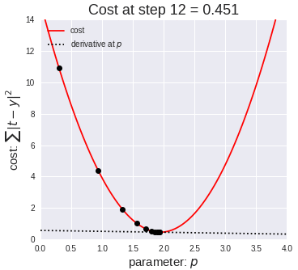
Gradient Descent
Iterative process used in ML to find local minimum in our loss function measuring errors
Moves in direction of steepest descent
Step size decreases as steepness lessens to avoid missing minima
Custom variants for NNs include adam optimization

Slide 20
Activation Function
Determines a node’s output given weighted sum of its inputs
The ReLu (rectified linear unit) is simple and a good choice for most networks
Returns zero for negative values and its input for positive ones
f(x) = max(0,x)

Slide 21
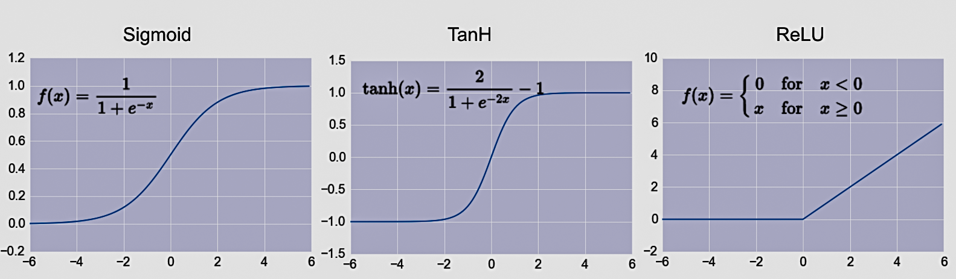
Common Activation Functions
Define the output of a node given an input
Very simple functions!
Choice of activation function depends on problem and available computational power
Comprehensive list of activation functions
In practice

Slide 22
Regularization
Parameter to control overfitting, i.e. when the model does well on training data but poorly on new, unseen data
L2 regularization is the most common
Using dropout is another common way of reducing overfitting in neural networks
At each training stage, some nodes in hidden layer temporarily removed (dropped out)

Slide 27

Hyperparameter optimization
How do we find the best settings for these hyperparameters?
Experimentation
Experiment with a range of different settings (e.g., for learning rate) via multiple runs
Use a grid search tool, e.g., scikit learn’s
Experience
Similar problems with similar data will probably benefit from similar settings

Slide 28
http://playground.tensorflow.org/

Slide 29
Deep Learning Frameworks (1)
Popular open-source deep learning frame-works use Python at top-level; C++ in backend
TensorFlow (via Google)
Keras (Open Source, now TensorFlow’s I/F)
PyTorch (via Facebook)
MxNet (Apache)
Caffe (Berkeley)
TensorFlow and PyTorch now dominate; both make it easy to specify a complicated network
Keras is now part of TensorFLow
Notes:
Demo: MNIST CNN
Demo: RNN sentiment

Slide 30

Keras
“Deep learning for humans”
A popular API works with TensorFlow provides good support at architecture level
Keras (v2.4 +) only supports TensorFlow
Supports CNNs and RNNs and common utility layers like dropout, batch normalization and pooling
Coding neural networks used to be harder; Keras made it easier and more accessible
Documentation: https://keras.io/

Slide 31
Demo

Slide 32
New problems are surfaced
2010s was a decade of domain applications
These came with new problems, e.g.,
Images are too highly dimensioned!
Variable-length problems cause gradient problems
Training data is rarely labeled
Neural nets are uninterpretable
Training complex models required days or weeks
This led to many new “deep learning” neural network models

Slide 33
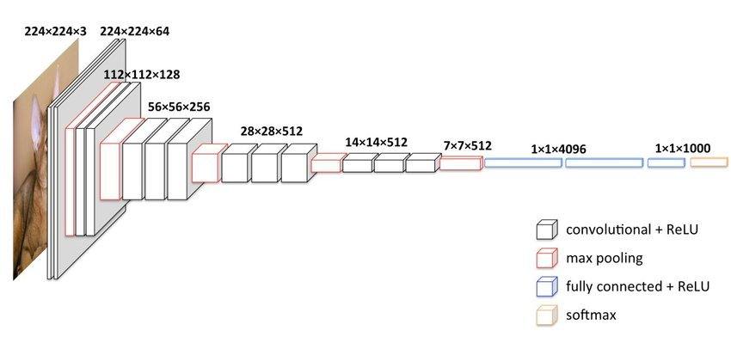
Deep Learning
Deep learning refers to models going beyond simple feed-forward multi-level perceptron
Though it was used in a ML context as early as 1986
“deep” refers to the models having many layers (e.g., 10-20) that do different things
22 layers!
The VGG16 CNN model for image processing

Slide 34
Neural Network Architectures
Current focus on large networks with different “architectures” suited for different tasks
Feedforward Neural Network
CNN: Convolutional Neural Network
RNN: Recurrent Neural Network
LSTM: Long Short Term Memory
GAN: Generative Adversarial Network
Transformers: generating output sequence from input sequence

Slide 35
CNN: Convolutional Neural Network
Good for 2D image processing: classification, object recognition, automobile lane tracking, etc.
Successive convolution layers learn higher-level features
Classic demo: learn to recognize hand-written digits from MNIST data with 70K examples
In-Depth

Slide 36
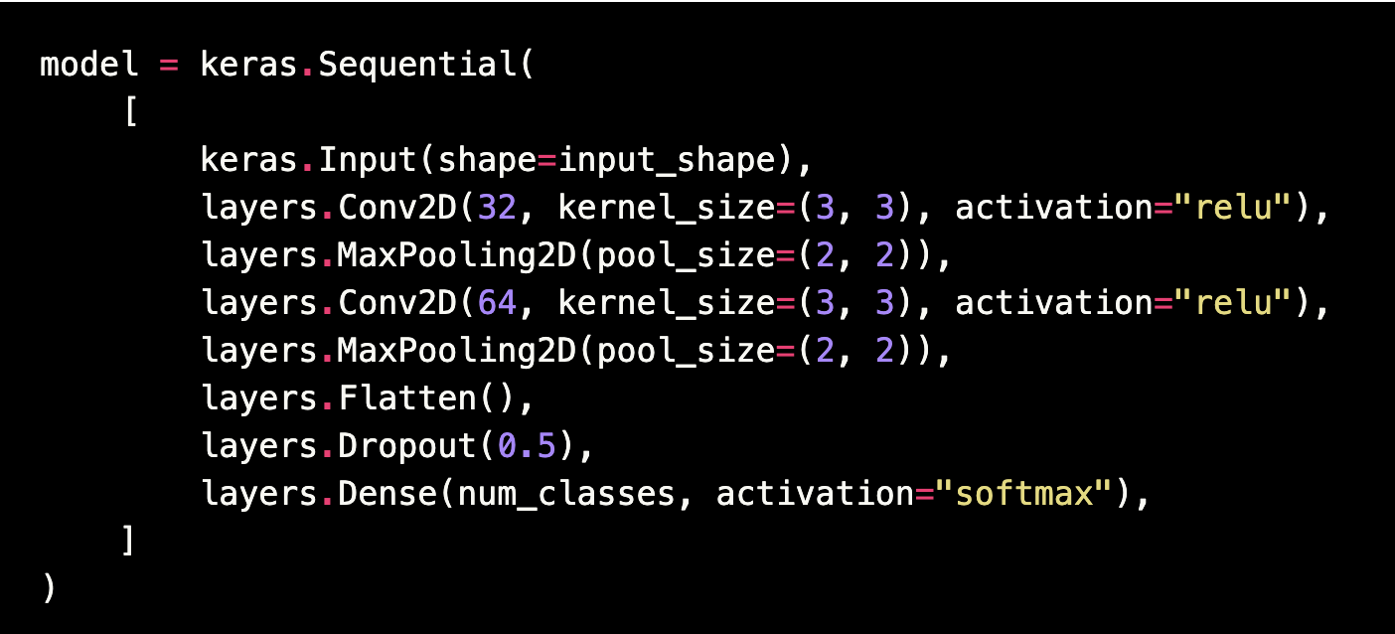
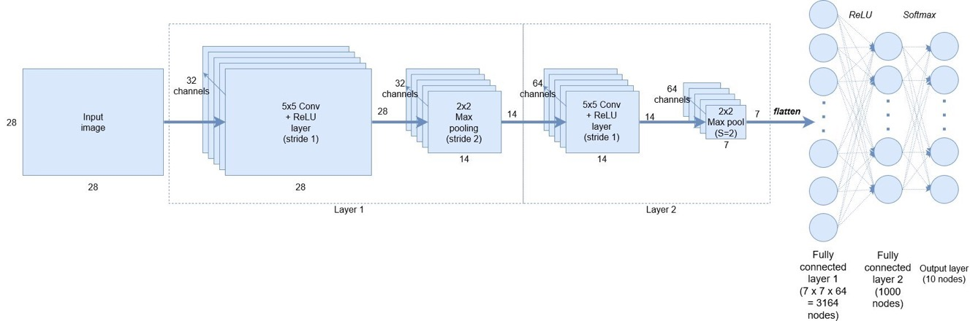
Keras: API works with TensorFlow
Example from a simple MNIST convolutional network
Notes:
Demo: MNIST CNN
Demo: RNN sentiment

Slide 37
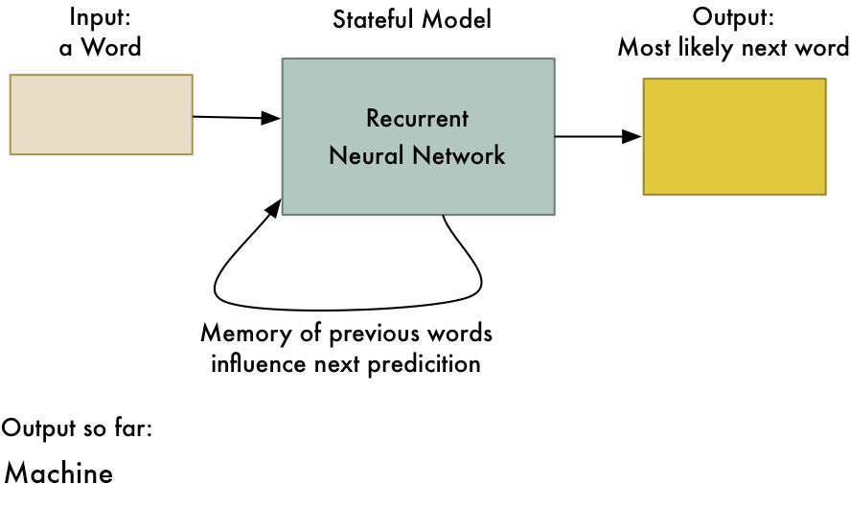
RNN: Recurrent Neural Networks
Good for learning over sequences of data, e.g., a sentence of words
LSTM: (Long Short Term Memory) a popular architecture that remembers and uses previous N inputs
BI-LSTM: knows previous and upcoming inputs
Attention: recent idea that learns long-range dependencies between inputs
from Adam Geitgey

Slide 38
GAN: Generative Adversarial Network
System of two neural networks competing against each other in a zero-sum game framework
Provides a kind of unsupervised learning that improves the network
Introduced by Ian Goodfellow et al. in 2014
Can learn to draw samples from a model that is similar to data that we give them

Slide 39
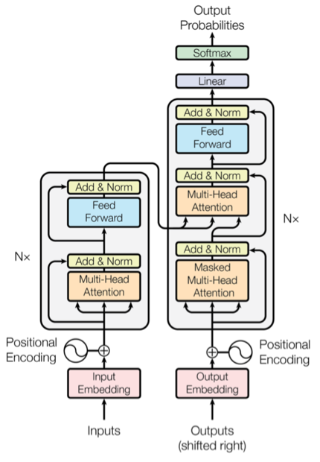
Transformer
Introduced in 2017 & has largely replaced RNNs
Used primarily for natural language & vision processing tasks
NLP applications ”transform” an input text into an output text
E.g., translation, summarization, question answering
Uses encoder-decoder architecture with attention
Popular pre-trainted models available, e.g. BERT and GPT

Slide 40
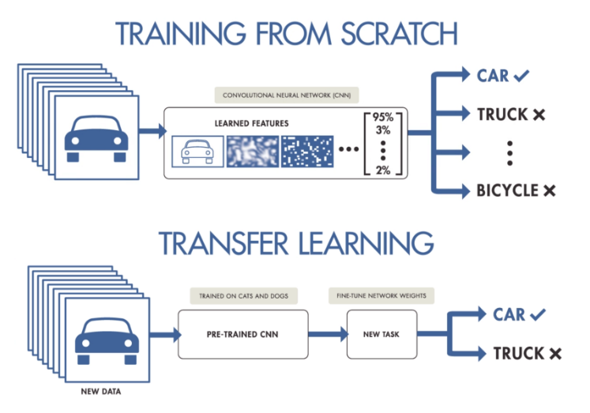
NNs Good at Transfer Learning
Neural networks effective for transfer learning
Using parts of a model trained on a task as an initial model to train on a different task
Particularly effective for image recognition and language understanding tasks

Slide 41
Good at Transfer Learning
For images, the initial stages of a model learn high-level visual features (lines, edges) from pixels
Final stages predict task-specific labels
source:http://ruder.io/transfer-learning/

Slide 42
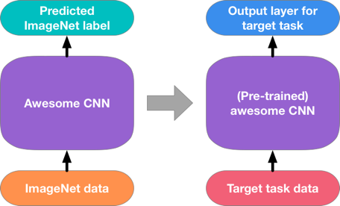
Fine Tuning a NN Model
Special kind of transfer learning
Start with a pre-trained model
Replace last output layer(s) with a new one(s)
One option: Fix all but last layer by marking as trainable:false
Retraining on new task and data very fast
Only the weights for the last layer(s) are adjusted
Example
Start: NN to classify animal pix with 100s of categories
Finetune on new task: classify pix of 10 common pets

Slide 43
Conclusions
Quick intro to neural networks & deep learning
Learn more by
Try scikit-learn’s neural network models
Explore TensorFlow with Keras / PyTorch
Work through examples
and then try your own project idea

